Slide 1
ENG 800: Bachelor Thesis Improving Drag & Drop
Adham Ahmed Kamel
Supervised by Dr. Wael Abouelsadaat

Slide 2

Outline
Improving Drag & Drop
Research Problem
Background & Related Works
Proposed Solution
Demo
Implementation Details
Conclusion

Slide 3


Research Problem
Improving Drag & Drop
How to improve Drag & Drop experience?

Slide 4

Background
Improving Drag & Drop
Human hand & phalanges
Layered data storage & retrieval​

Slide 5
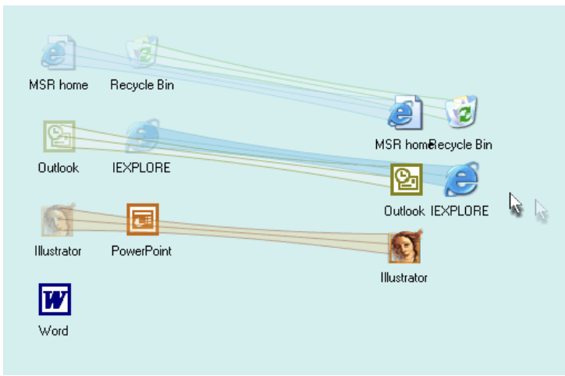
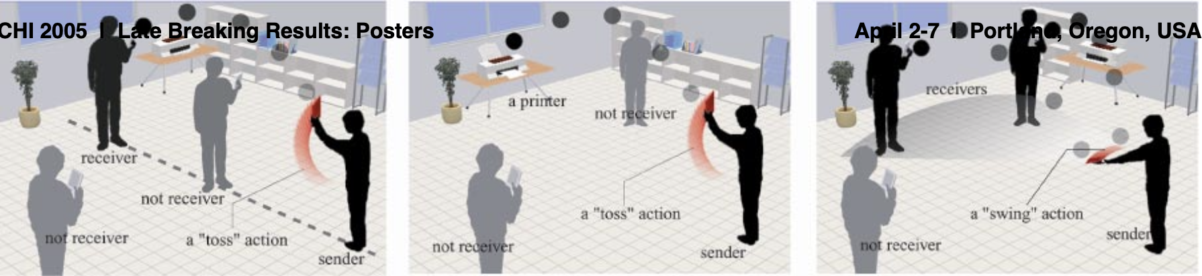

Related Works
Improving Drag & Drop
"Drag and Pop & Drag and Pick”
Patrick Baudisch and co.
Drag and Pop 3.7x faster than drag and drop
”Toss-It”
Koji Yatani and co.
Data transfer system
Swing action
Toss action

Slide 6
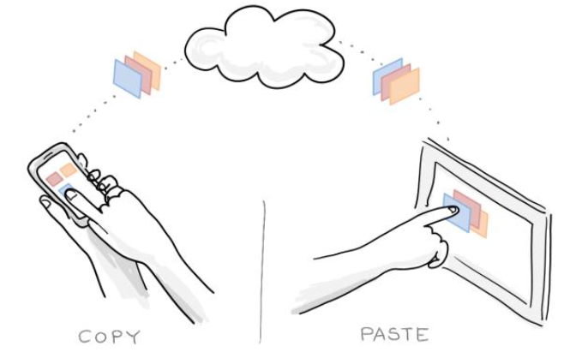

Related Works
Improving Drag & Drop
SPARSH: Passing Data Using The Body as Medium
Pranav Mistry and co.
Touch based
Easy to use
Accessible Auditory Drag And Drop
Quadrants
Tone and audio orientation
Feedback

Slide 7
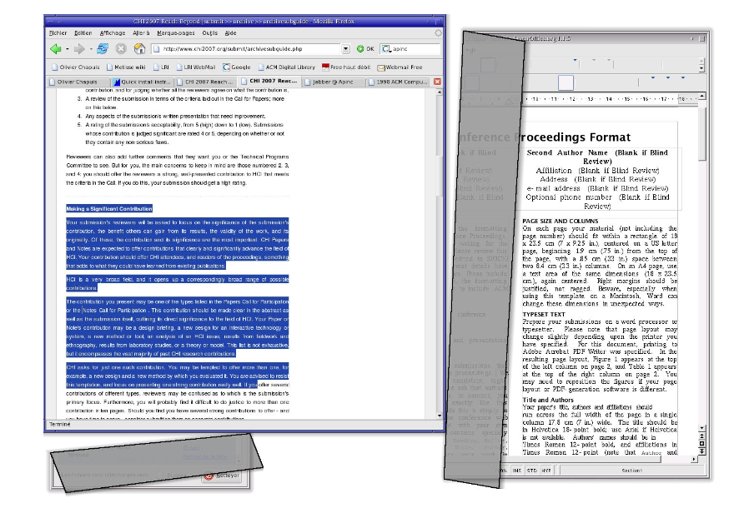
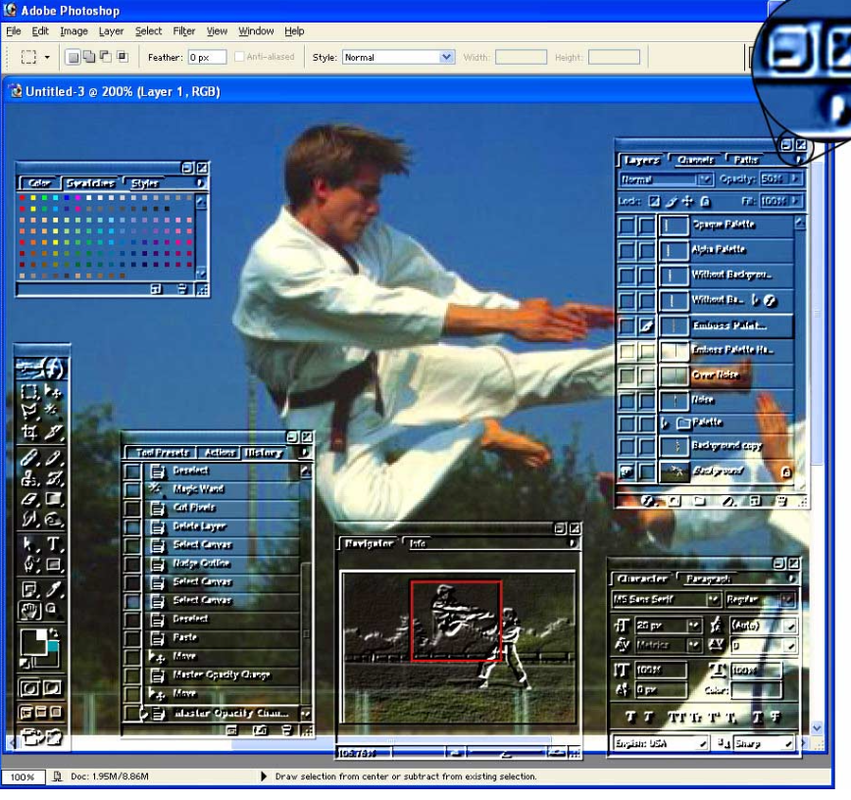

Related Works
Improving Drag & Drop
Copy and Paste Between Overlapping Windows
Olivier Chapuis and Nicolas Roussel
Roll copy and paste
Restack copy and paste
Multiblending
Patrick Baudisch and Carl Gutwin
Alpha channel manipulation

Slide 8
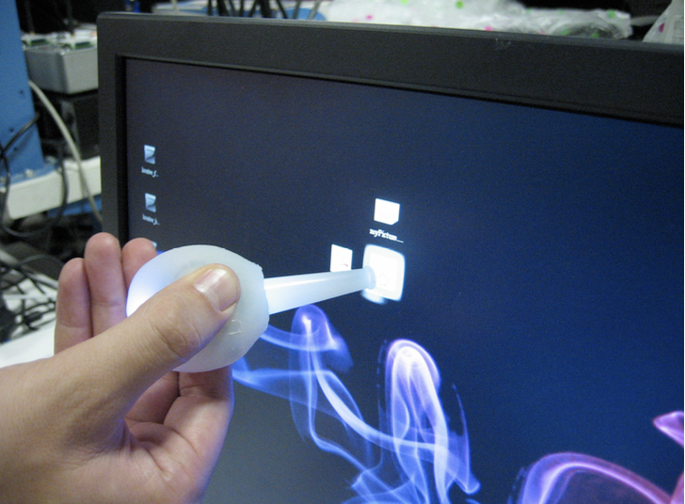
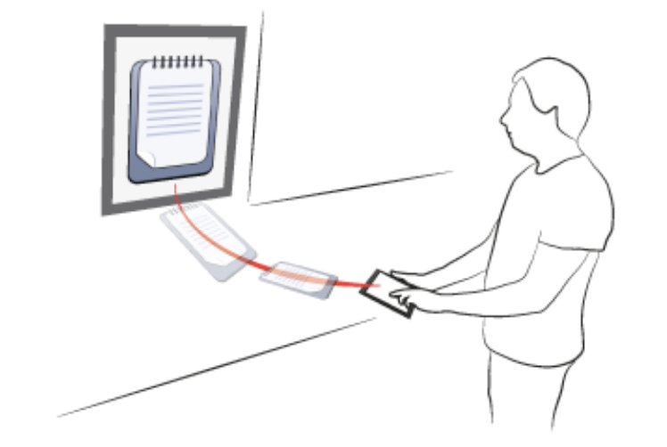

Related Works
Improving Drag & Drop
Slurp
Jamie Zigelbaum and co.
Eye dropper shaped apparatus
Eye Pull, Eye Push
Jason Turner and co.
Gesture based
Hand eye coordination

Slide 9
Proposed Solution
Improving Drag & Drop
Use phalanges to enable cross device drag and drop utilizing layering, spatial memory, and cloud storage

Slide 10


Improving Drag & Drop

Slide 11

Implementation Details
Improving Drag & Drop
Palm recognition
Machine learning​
Geometric analysis
Layering and spatial memory
Google drive integration

Slide 12
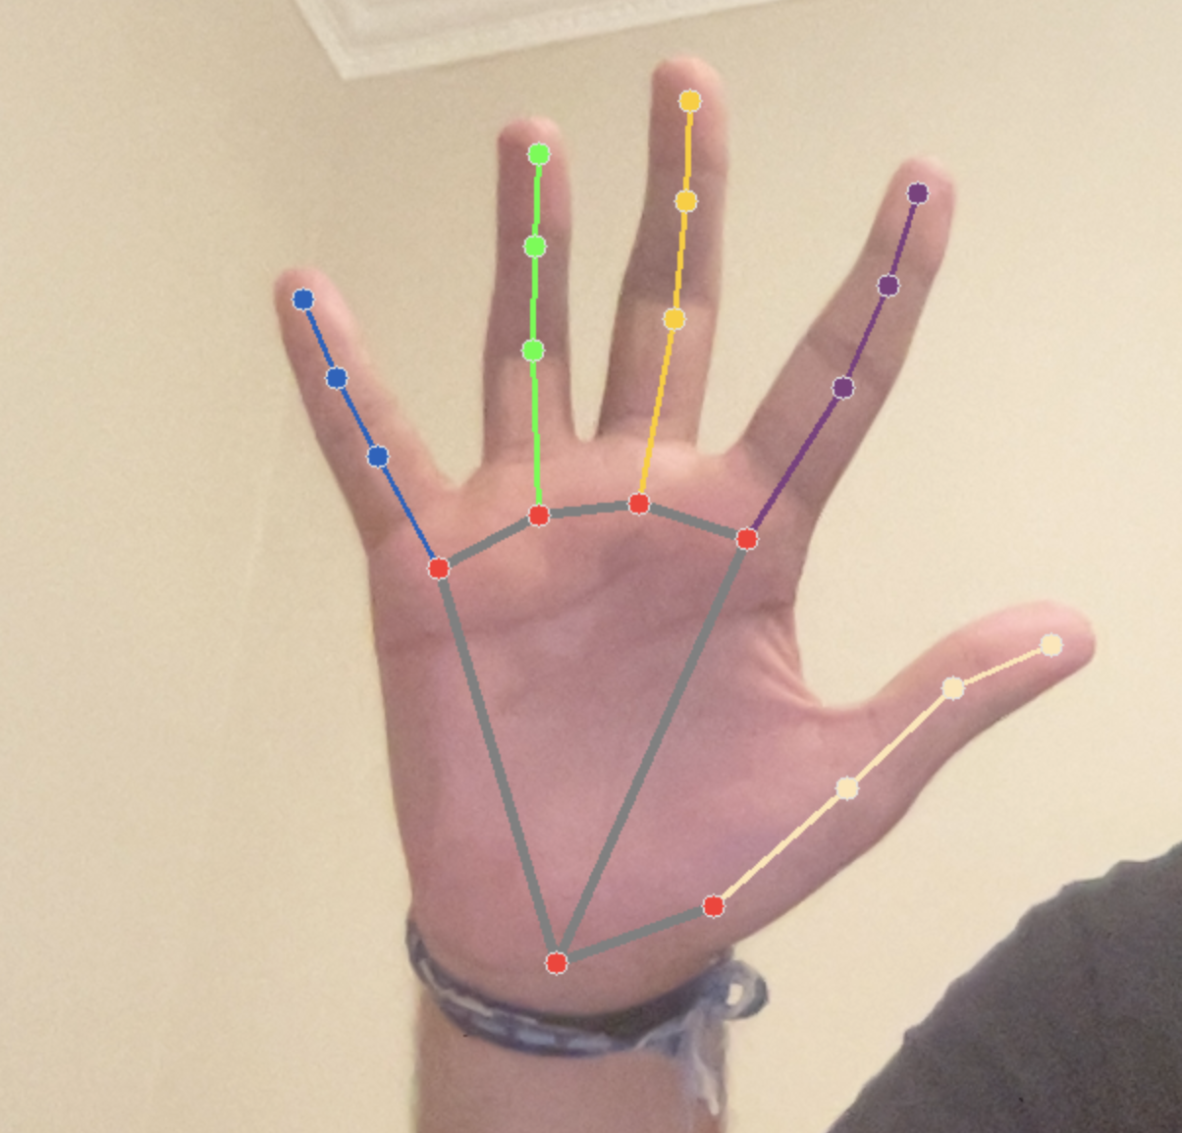

Palm recognition
Improving Drag & Drop
Secure Authentication
Ready made python library
Mediapipe
Captures image for comparison
Distance between key features
Threshold based
We take the average of multiple comparisons

Slide 13

Machine Learning
Improving Drag & Drop
Collect Data
Process Data
Split data into Training and Testing sets
Initialize Random Forest Classifier
Evaluate Model
Save

Slide 14
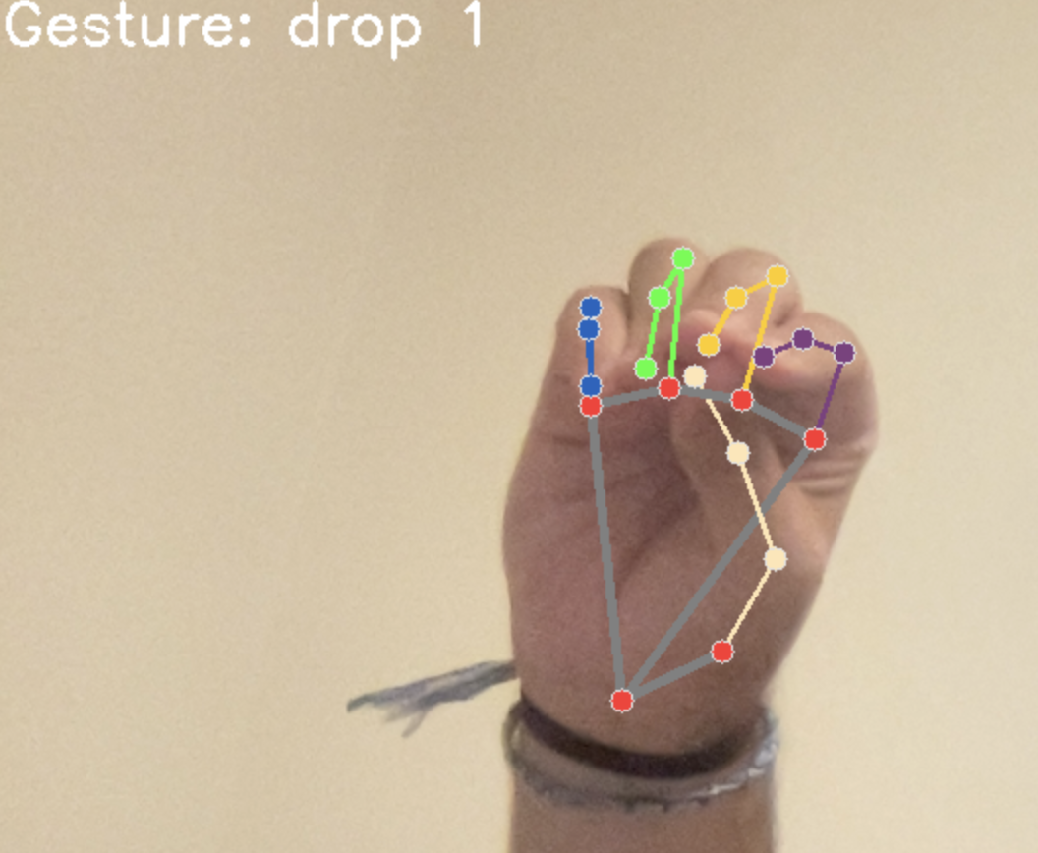
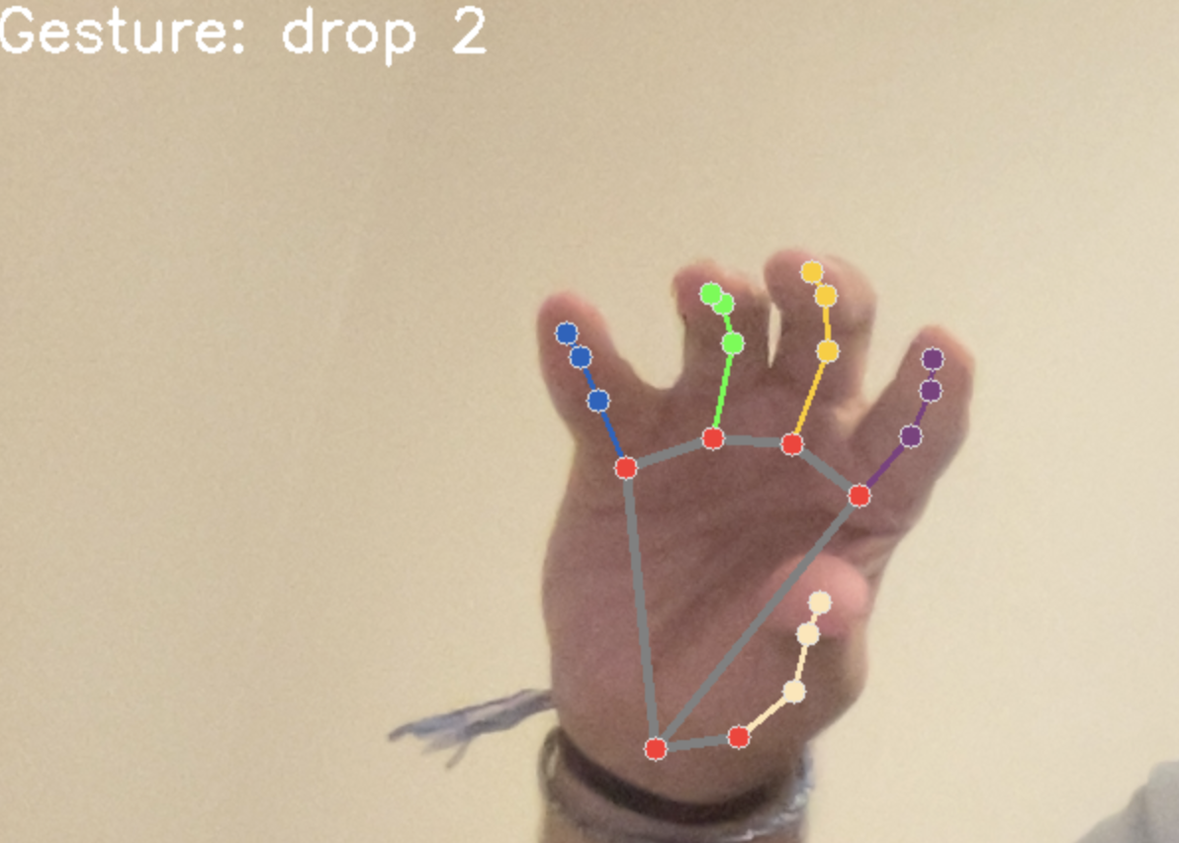
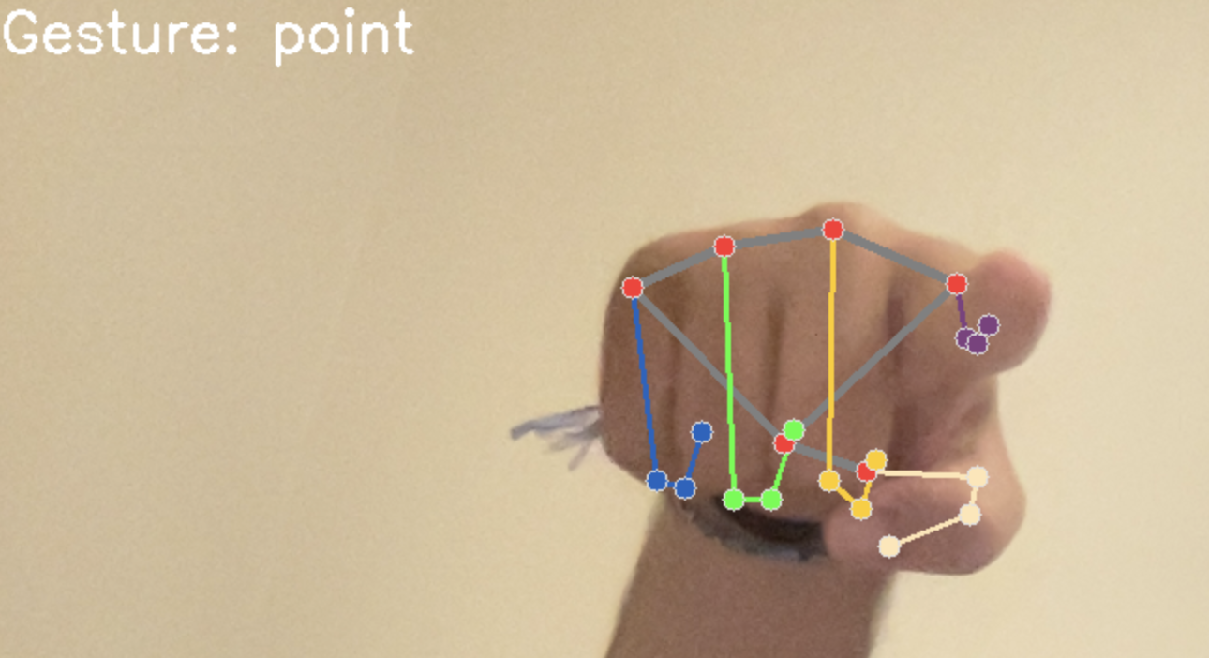
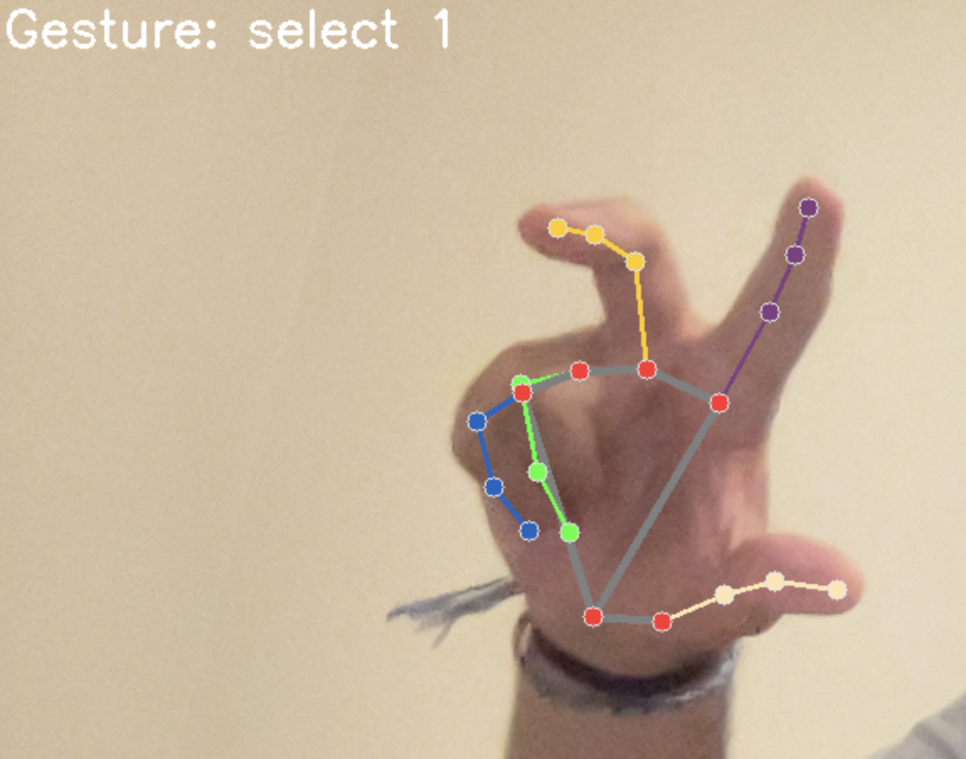
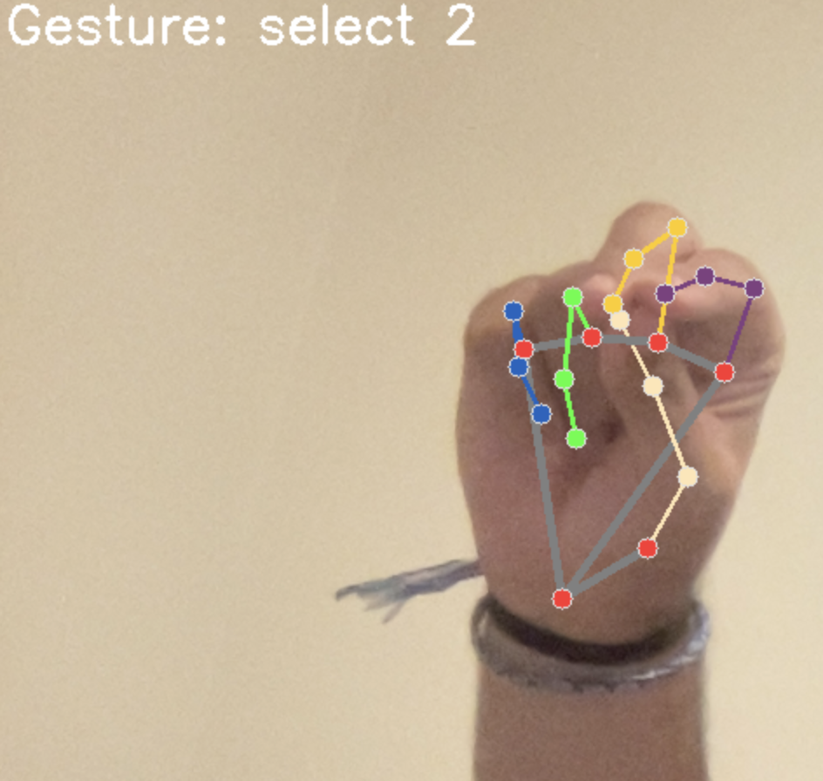

Gestures Detected by Machine Learning
Improving Drag & Drop

Slide 15
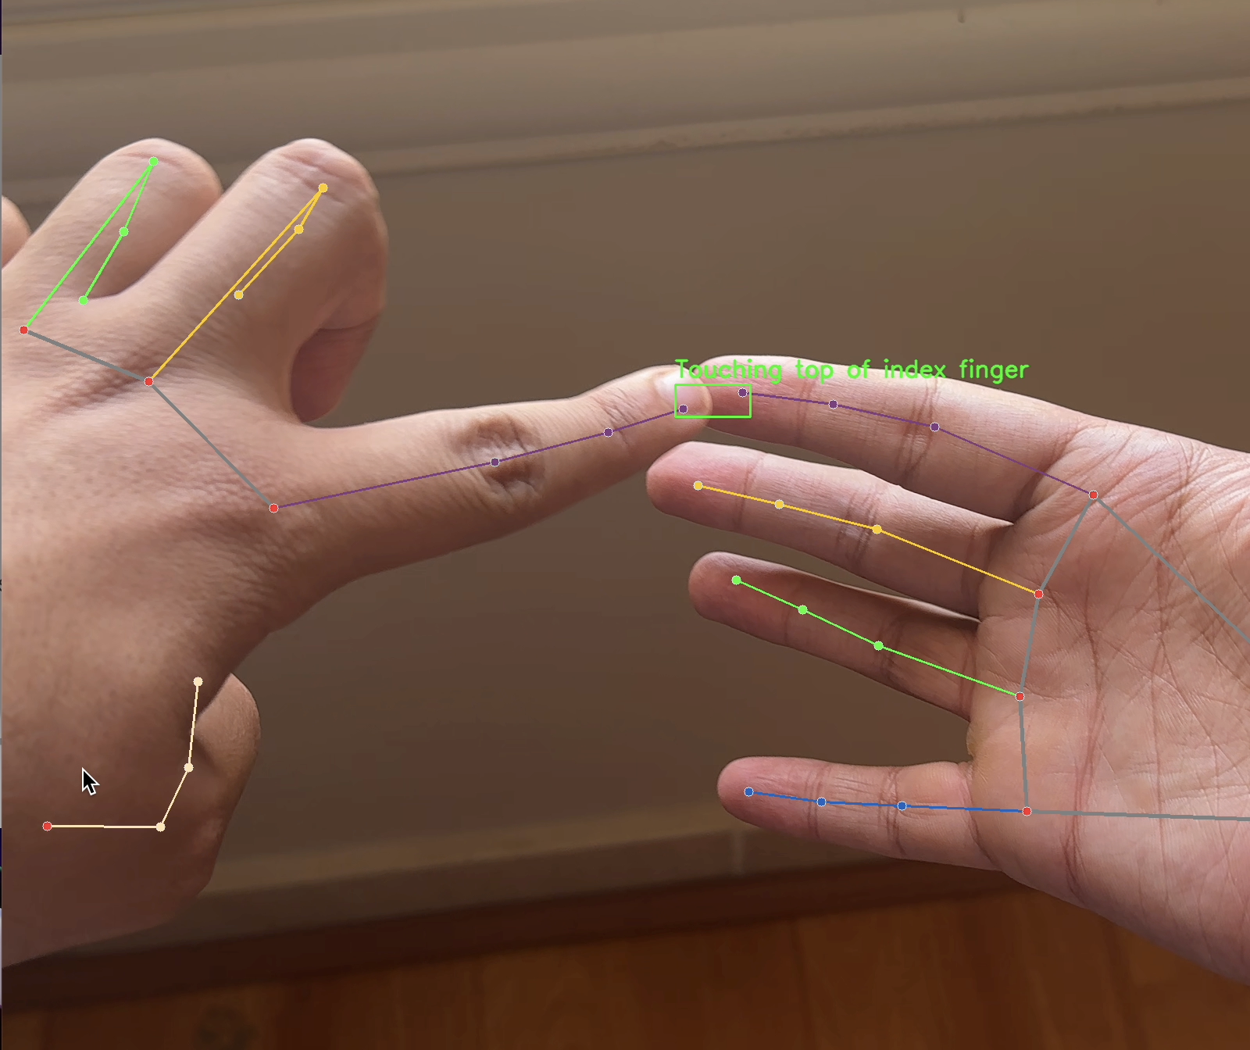
Geometric Analysis
Improving Drag & Drop
Real time Euclidean distance calculation
Mediapipe
Threshold based
High accuracy

Slide 16
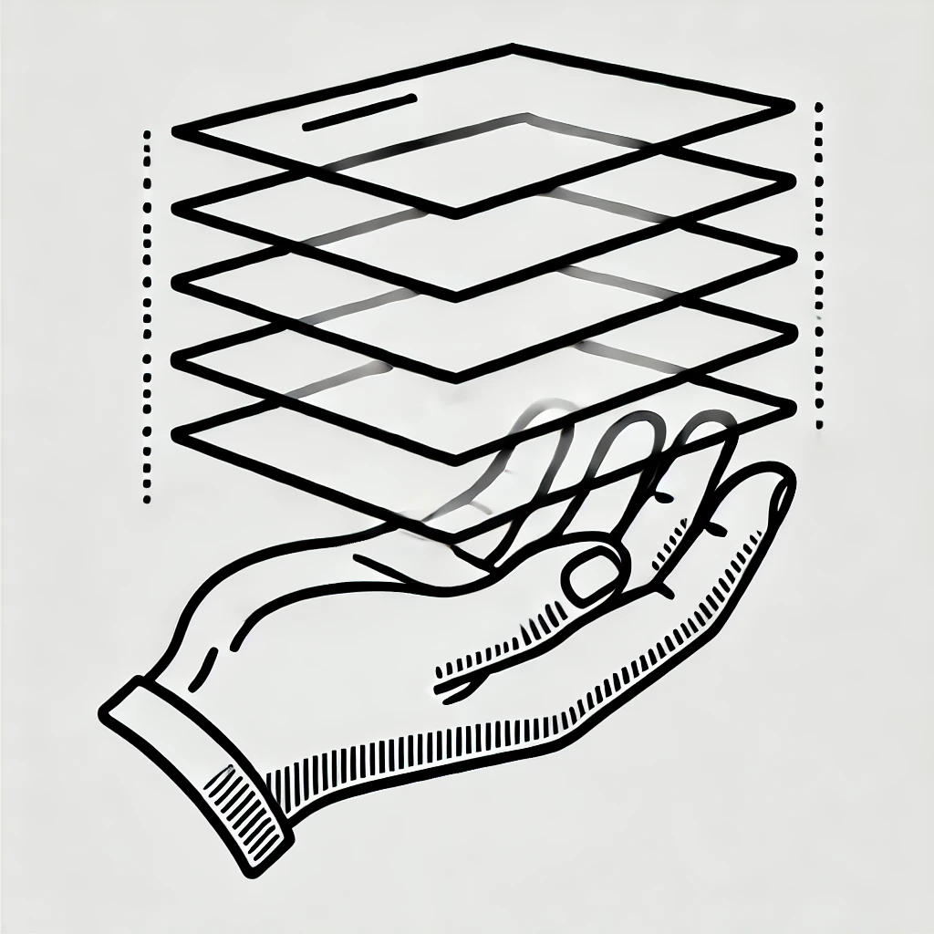

Layering & Spatial Memory
Improving Drag & Drop
Spatial memory helps users remember and locate items easily.
The concept of layering organizes items into different levels for better management.
This approach enhances the user experience by mimicking natural object arrangement and recall.
Improved functionality simplifies access and use in the drag-and-drop interface.

Slide 17

Google Drive Integration
Improving Drag & Drop
Cloud data management
Secure
Enables Cross device data transfer

Slide 18

Exploratory Study
Improving Drag & Drop
15 Test subjects
Tested on their spatial memory recall accuracy and time
7/12 average recall accuracy (58.3%)
0.8 second average recall time
Users that used spatial memory did better (avg 9/10) than those who claimed they used short term memory (avg 3/10)

Slide 19

Conclusion
Improving Drag & Drop
Achieved a working gesture based drag and drop that support changing layers, picking up object, and dropping objects
Limitations
Future work

Slide 20

Q&A
Improving Drag & Drop

Slide 21
Thank you
Improving Drag & Drop

